Slide 1

The Unique Characteristics of Borderline Personality Disorder (BPD) and Suicide Loss from the Perspective of Family Survivors
American Association of Suicidology Conference 2019
Thursday, April 25, 2019
Panelists: Deborah Chillemi, Lynn Courey, Paula Tusiani-Eng, LMSW, & Barbara Walker; Moderator: Marianne Goodman, MD

Slide 2
BPD Quiz - True or False?
1. Borderline Personality Disorder is caused by poor parenting or abuse.
2. Borderline Personality Disorder is as serious a mental illness as major depression, bipolar disorder, or schizophrenia.
3. 90% of those with BPD survive with treatment or support.
4. Medications are effective to treat BPD.
5. Evidence-based treatments for BPD are covered by health insurance companies.

Slide 3







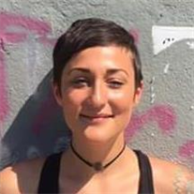

Slide 4
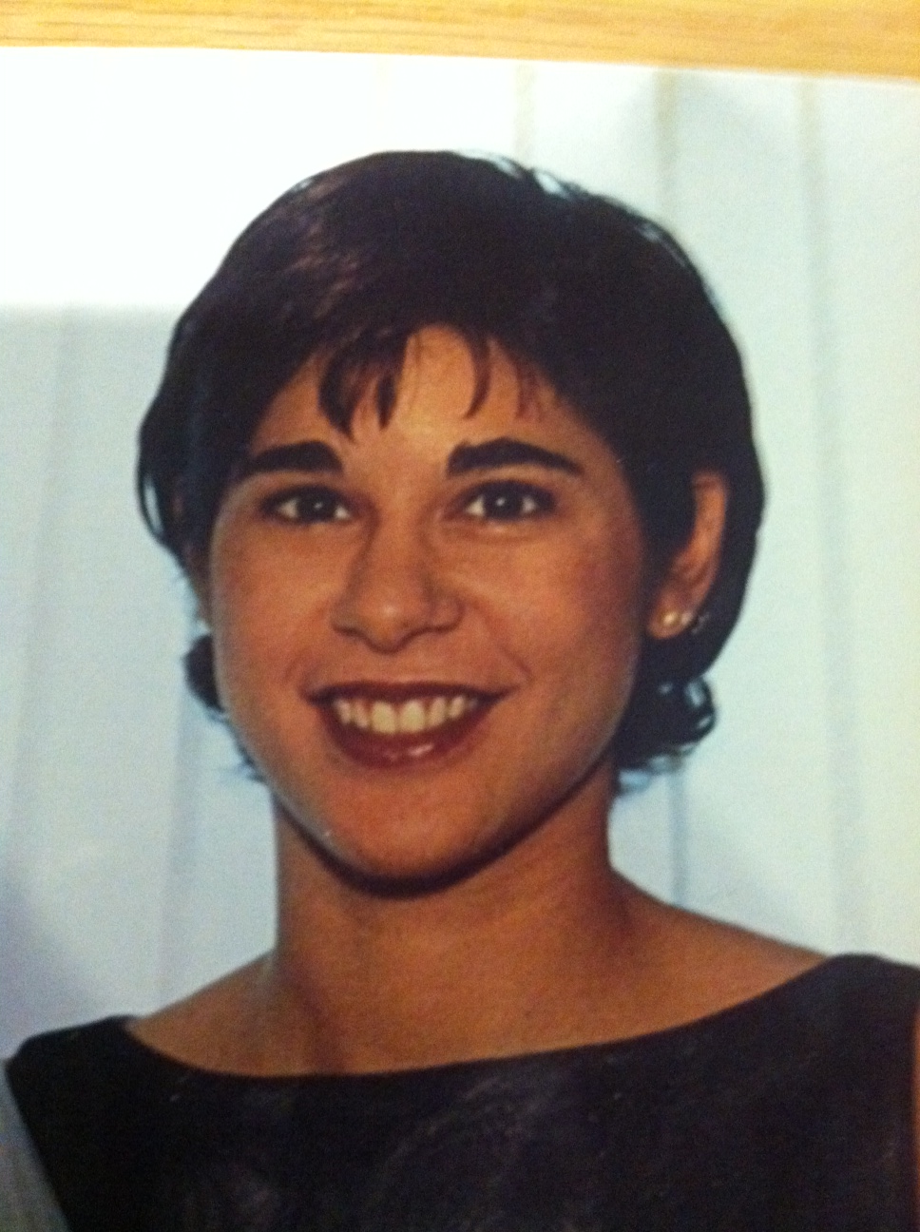

Pamela Ann Tusiani
September 14, 1977- April 19, 2001

Slide 5
What is BPD?
Borderline Personality Disorder (BPD) is characterized by five of the following nine criteria (DSM-V):
1) Frantic efforts to avoid real or imagined abandonment.
2) A pattern of unstable intense personal relationships characterized by alternating extremes of idealization and devaluation.
3) Identity disturbance marked by a persistently unable self-image or sense of self.
4) Impulsivity in at least two areas which can be potentially self-damaging (spending, substance abuse, reckless driving, binge eating, etc.)
5) Recurrent suicidal behavior, gestures, threats or self-mutilating behavior.
6) Affective instability due to a marked reactivity of mood (irritability, anxiety, etc.) which can last up to few hours, rarely more than a few days.
7) Chronic feelings of emptiness.
8) Inappropriate intense anger or difficulty controlling anger (frequent displays of temper, physical fights, etc.)
9) Transient, stress-related paranoid ideation or severe dissociative systems.

Slide 6
BPD Is...
A serious mental illness characterized by difficulty regulating emotions, affecting behaviors, relationships, stability, and sense of self.
Brain studies shows individuals with BPD have an underactive prefrontal cortex and an overactive amygdala which impairs emotional regulation.
BPD is caused by a combination of genetic, social, environmental and psychological factors.
This causes distorted thoughts, unstable relationships, difficulty communicating emotions, confused identity, extreme sensitivity, impulsive behavior, self-harm, or suicidality.

Slide 7

How is BPD Experienced by Sufferers?
“My brain is on fire.”
“It’s like driving driving a car that’s accelerating and you can’t hit the brakes.”
“It’s like riding a rollercoaster with emotional ups and downs all day long.”
Individuals impacted by BPD live in constant emotional pain, which can lead to chronic feelings of emptiness.

Slide 8

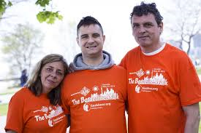


Two Mothers, Two Foundations in US and Canada
in memory of Daughters deceased from BPD
Lynn Courey,
Toronto, Canada
Meu

Slide 9



2016 Change.org Petition to NIMH for More BPD Research
Meeting Barbara Walker of Waterloo, Iowa

Slide 10

Sisters Connecting… American Foundation for Suicide Prevention Walks 2016
Michelle Rose Monachino Foundation
Meeting Yvette Monachino and Deborah Chillemi
Paula Tusiani-Eng
Emotions Matter, Inc.

Slide 11
Gaps Identified in BPD Loss Research & Grief Support
2015-2016 BPD Loss Survivors Meet & Connect
2017 - Established Emotions Matter Borderline Personality Disorder Loss Registry
2017 Launched Monthly Telephone BPD Loss Support Group
Group has met over two years involving up to 20 family members who have lost loved ones to BPD by suicide, drug overdose or inadequate care.
2017 - Created a BPD & Suicide Fact Sheet
2019 - BPD and Suicidality Fact Sheet Revised; AAS Panel

Slide 12


Lena Walker - Waterloo, Iowa
(May 18, 1996-Nov. 12, 2015 (19 yo)
BPD Symptoms:
Truancy from School
Drugs
Risky behaviors
Unstable romantic relationships
Shoplifting
Anxiety
Depression
Lena happy. Lena’s Prom Picture.

Slide 13

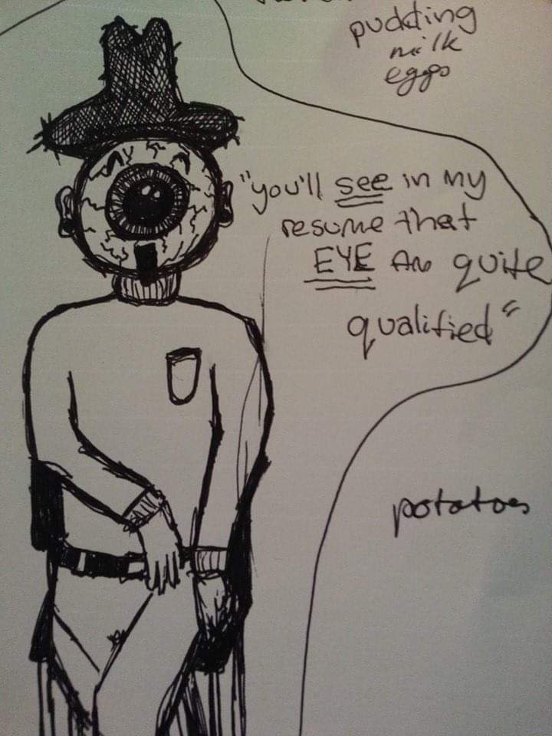
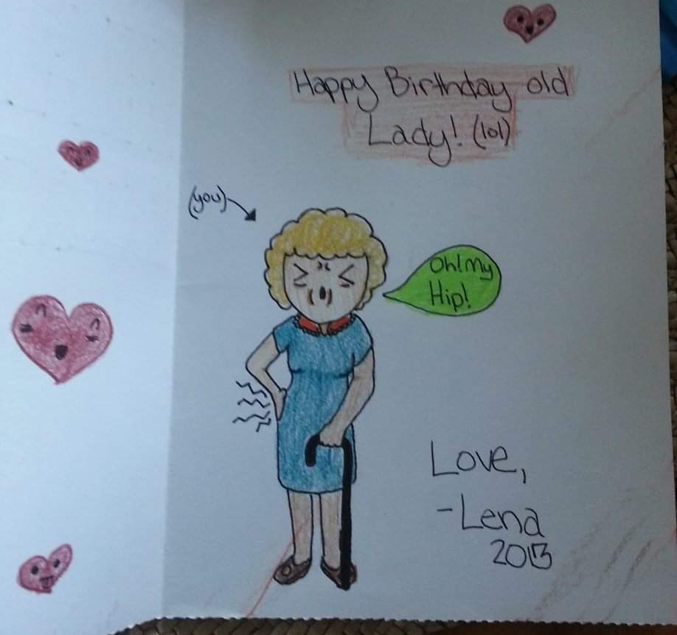
Lena’s Artwork and Sense of Humor

Slide 14
Reflections on Lena Walker’s Story
Struggles and Barriers to help:
Getting a BPD Diagnosis
Accessing Treatment in Iowa
HIPPA Laws
Lack of family education about BPD

Slide 15


Barriers to Care for High Functioning Youth:
Sasha Menu Courey’s Story
March 10, 1991 to June 17, 2011. (20 yo). Toronto, CA
Early years 11-13
  First encounter with mental health professionals disregarded trouble dealing with emotions
  High functioning behaviour masking underlying issues
Adolescence - first suicide attempt at 16
  Diagnosed as “teenage angst”
  Disregarding delta change in behaviours, focusing on high functioning
  Too young for formal diagnosis 🡪 no access to proper treatment
  Labeled as a difficult non cooperating patient
  Outpatient treatment ended without follow up or other resources

Slide 16
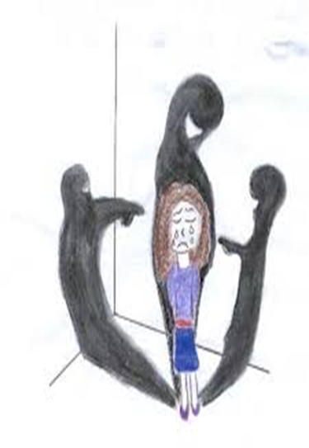
BPD Stigma on the Way to Get Help
At 20…diagnosed with BPD after second suicide attempt.
Stigma from mental health professionals
  Few professionals want to treat BPD patients - Cannot find family doctor or services due to BPD diagnosis and suicidal behaviour
    “Don’t mention she has BPD to find services”
Stigma from relatives and friends
  Negative attitudes, prejudices and discriminations:
    “How can you do this to your parents?”
    “She is just trying to get your attention”

Slide 17


Crisis Intervention and Emergency room challenges
At 20….second suicide attempt
  Blaming and invalidating patient due to their suicide attempt
  “You really did a number on yourself”
  “You are so disrespectful of your parents”
  Family feeling of blamed by service providers for patient’s situation
  No communication with family regarding assessment/status of patient
  Quick discharge- family becomes first line responders with no skills or training

Slide 18


Finding Effective BPD Treatment covered by Health Insurance
At 20….second suicide attempt
  Insurance not covering residential DBT treatment
  Few want to treat BPD patients or highly suicidal patients
  Evidence-based treatments for BPD not easily accessible or affordable
  Long wait lists for affordable treatment

Slide 19

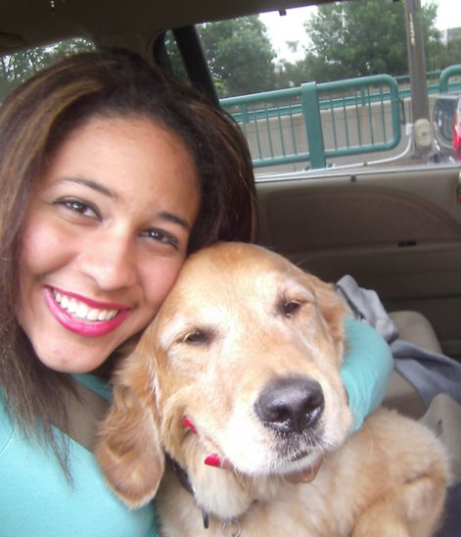
BPD at a glance… saying goodbye!

Slide 20
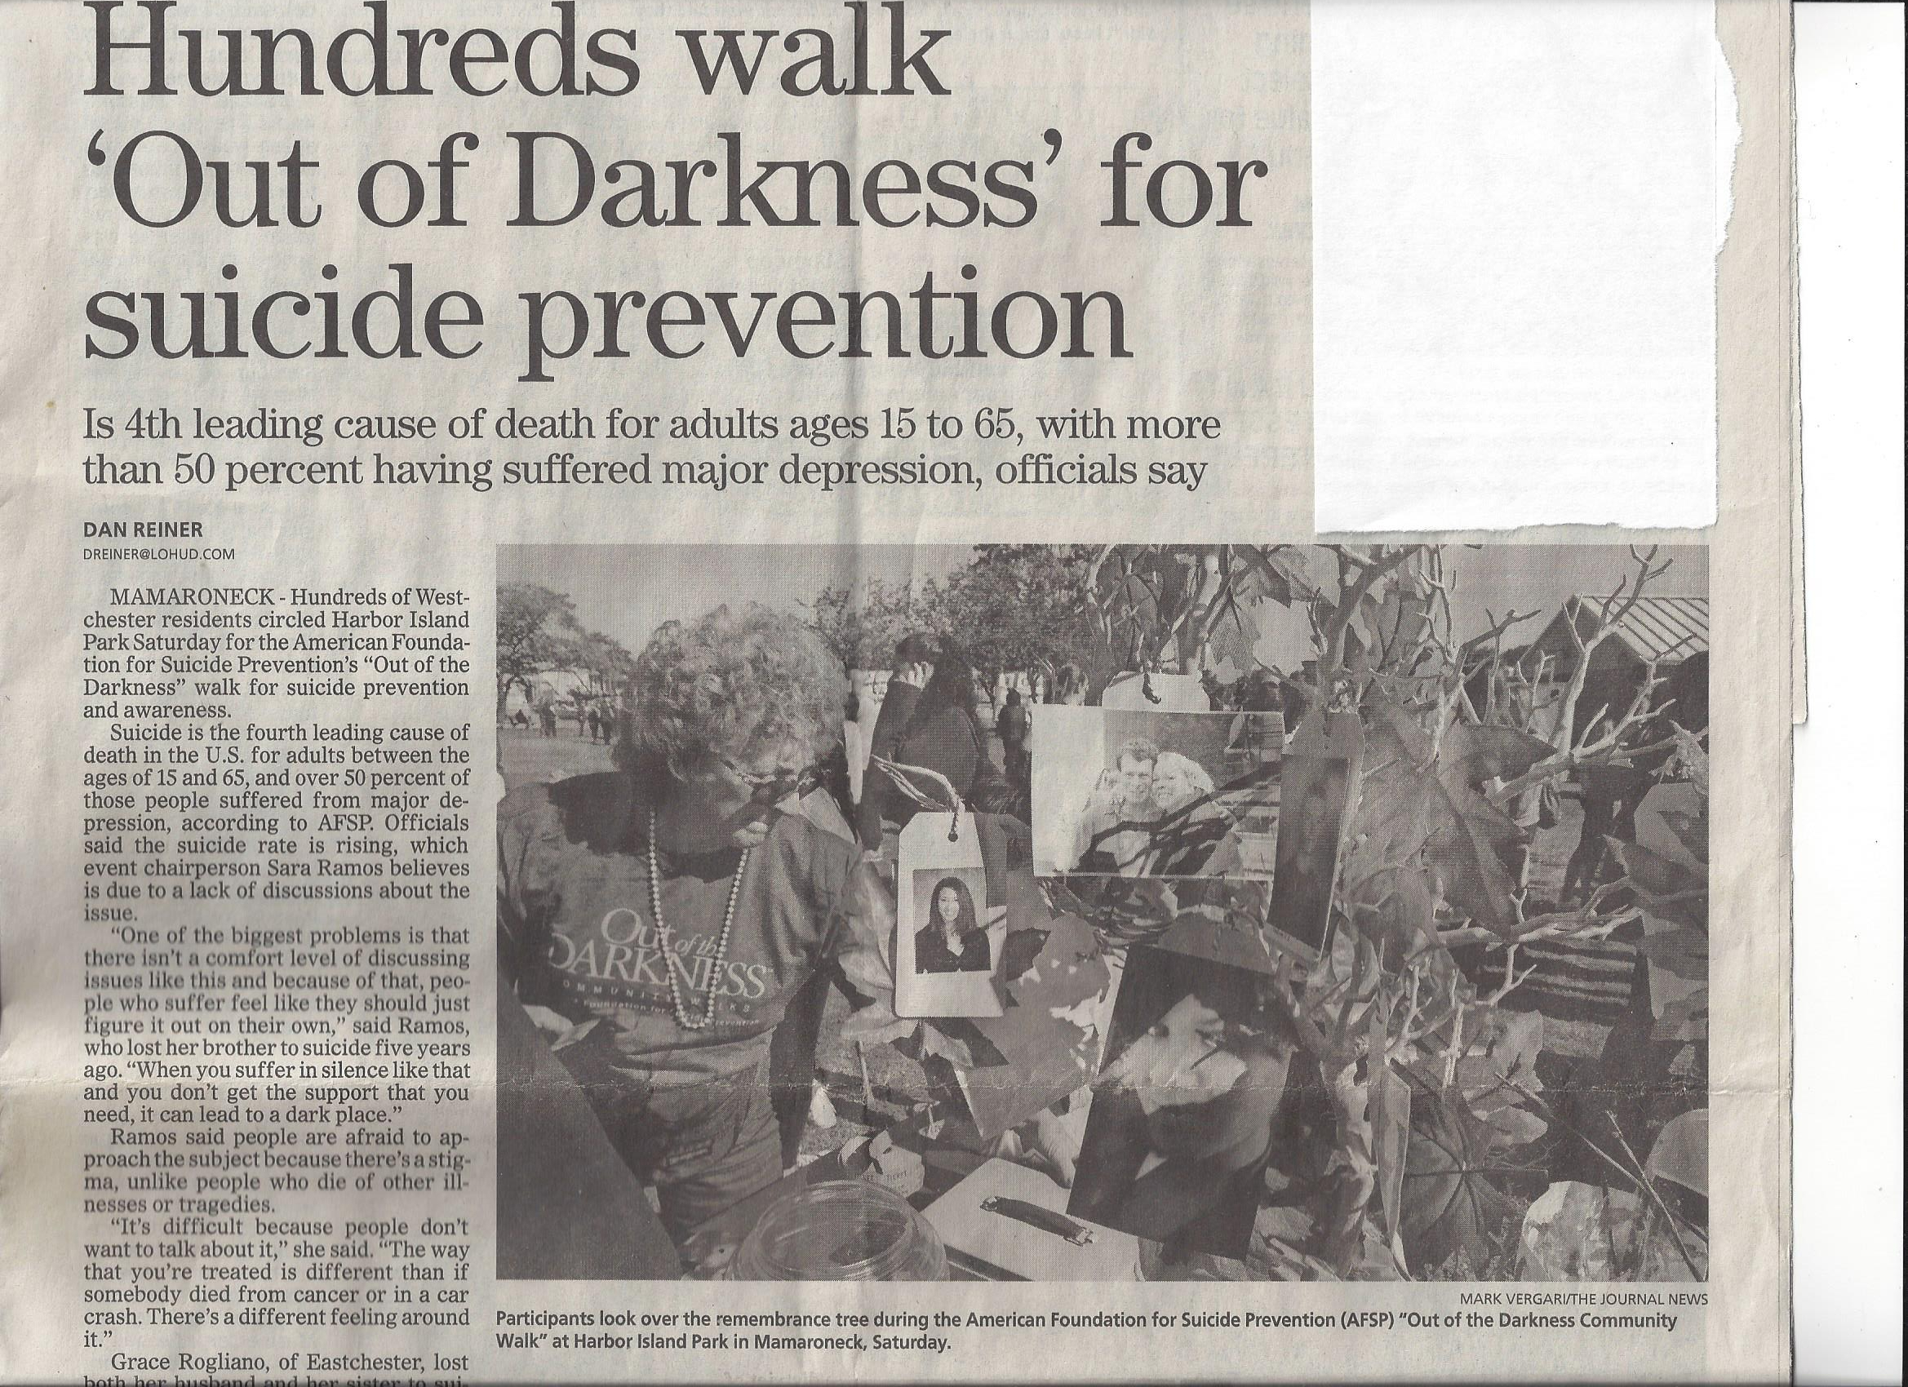

Slide 21


Slide 22


Slide 23

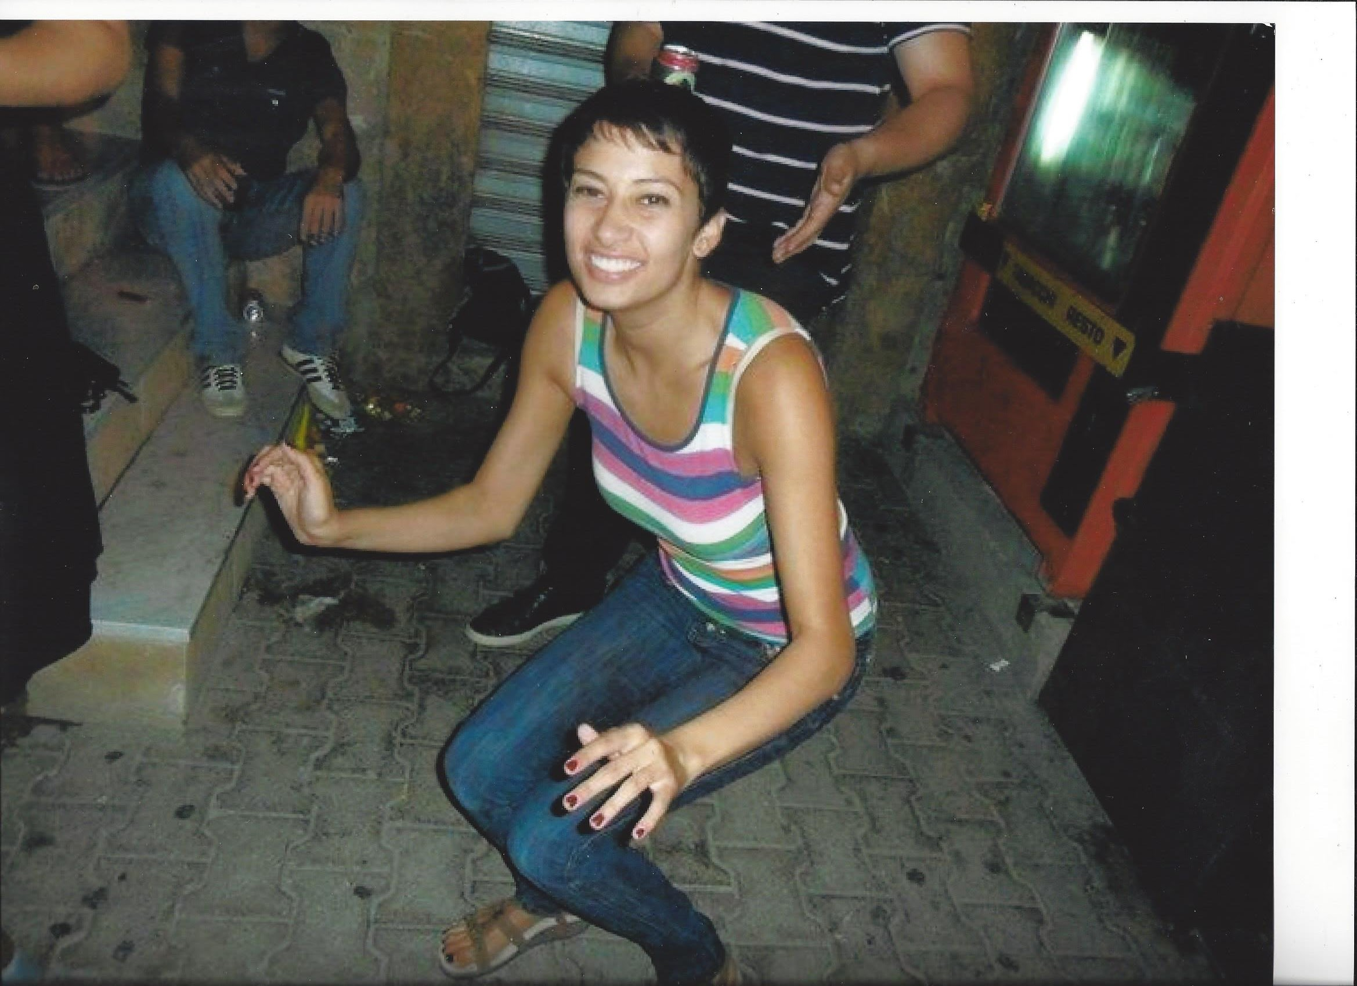
Michelle Monachino
Cortland Manor, New York
(July 25, 1989 to March 28, 2016)
Michelle dressed as Audrey Hepburn.

Slide 25
BPD Statistics
BPD affects up to 6% of the population.
80% of those hospitalized with BPD have engaged in self-harm or non-suicidal self injury.
Up to 75% of those with BPD attempt suicide during the course of their illness.
50-80% of those diagnosed also have a substance abuse disorder.
Sadly, up to 10% of individuals with BPD lose their lives to suicide.
More than 90% survive with access to treatment and support, but these resources are difficult to afford and access across the United States. This is a public health crisis.

Slide 26
Barriers to BPD Recovery & Risk Factors for Suicide
Difficulty getting a BPD diagnosis.
Conflicting information from health care professionals about BPD.
HIPPA laws preventing parents from information to protect loved ones.
Difficulty finding affordable evidence-based treatment covered by insurance.
Negative experiences with crisis intervention/emergency room care.
Experiences of stigma and discrimination.
Difficulty getting care for high functioning children with social, behavioral, or functional disabilities as a result of BPD.
Lack of community support and educational resources.
Challenges finding treatment for co-occurring disorders/substance abuse.

Slide 27
Public Health Recommendations for BPD
1. Increase training of healthcare professionals to diagnose, refer, and treat BPD using evidence-based interventions.
2. Increase training of emergency and crisis specialist regarding best BPD practices to support those impacted by self-harm and suicidality.
3. Identify BPD as a high risk population for suicide loss.
4. Improve mental health literacy and public education about BPD as a serious mental illness.
5. Advocate for increased access to evidence-based treatments through parity for insurance reimbursements on par with others serious mental illness.

Slide 28
Unique Factors of BPD Loss & Grieving
BPD Loss is a form of complicated grief because families already traumatized by trajectory of illness, having been repeatedly exposed to self-harm, suicidality, and impulsive behaviors.
Those who die as a result of BPD and suicide typically accessed mental health services in the months prior to their death. Loved ones were aware and actively trying to help them.
Death by BPD and suicide is often caused by a myriad of social, economic and political factors in addition to the way the illness presents in the individual. These may include lack of access to treatment, education, stigma around BPD, etc.
It is important for family members to not just blame themselves, or their loved ones – but to validate their lived experiences of not being able to help their loved ones.

Slide 29

“Going to lose my mind, not because I have BPD, but because of all the stigma attached to it. PLEASE educate yourself before you judge me :)”
“Wouldn’t it be great if we can talk about our problems/illnesses or show our scars without judgement from others?”
https://ottawacitizen.com/news/local-news/lauren-richards-took-her-own-life-at-26-she-left-behind-devastated-loved-ones-and-a-haunting-question
- Lauren Richards posted on Instagram a month before her death. She took her own life on Feb. 21, 2019. She was 26.

Slide 30
BPD Features to Sort Through after Loss
Fear of abandonment
Disorganized or extreme attachment
Overattachment/dependence of child on family for survival
Impulsivity and self-harm, impact of walking on egg shells, trauma from suicidality
Projection, blaming family for problems and escalated emotions related to BPD
Identifying family patterns of BPD traits after death of loved one
Acknowledging times when family was not validating or may have contributed to symptoms, not knowing how to help.
Acknowledging times when loved one hurt them or did not act to support their recovery.

Slide 31
How BPD Specific Loss Group Helps
Helps loss survivors identify BPD as cause of death, beyond the label as death by suicide.
Provides psychoeducation about BPD, answering questions Loss Survivors have about the illness and its impact on them and their loves ones.
Connects loss survivors with others who understand parent’s experience of BPD.
Provides a safe space for BPD loss survivors to reframe their loved one’s life and death story within the context of BPD. This includes identifying patterns of BPD behavior, attachment, perceptions of self and others, difficulty accessing resources, support and treatment for their loved ones, etc.
Helps those with BPD loss move through the normal stages of grief: anger, denial, bargaining, depression and acceptance, and along with trauma symptoms. But helping them understand their loss is more complicated, and it may take more time and support to heal.
Model Action and advocacy as form of coping and healing with injustices around BPD loss.

Slide 33
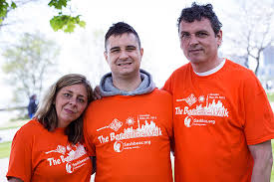
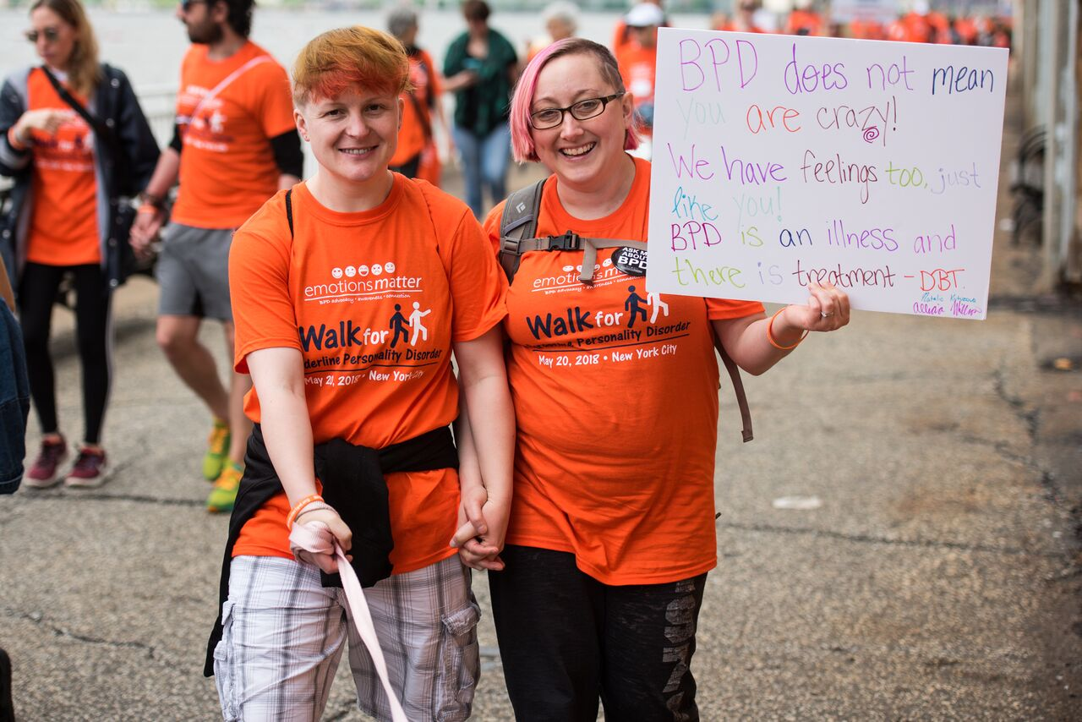
Resiliency and Hope

Slide 34
BPD Specific Resources
 National Education Alliance for Borderline Personality Disorder. Family Connections & Tele-Connections – 12-week manualized family programs and teleconferences which are offered around the country. neabpd@aol.com www.borderlinepersonalitydisorder.com
 New York Presbyterian Borderline Personality Disorder Resource Center. Offers free resources and referrals for providers, families and individuals. 1-888-694-2273. www.nyp.org/bpdresourcecenter; bpdresourcecenter@nyp.org
Treatment and Research Advancements, National Association for Personality Disorder (TARA). Provides workshops, referrals, information. 1-888-4-TARA APD or www.TARA4BPD.org.
Local/Community Organizations: Sashbear, Emotions Matter, New England Personality Disorders Association, Florida BPD Association.
Treaters: Behavioral Tech.

Slide 35
BPD Evidence-Based Treatments
Dialectical Behavioral Therapy (DBT): A form of CBT that teaches mindfulness, emotional regulation, interpersonal effectiveness skills, and distress tolerance.
Good Psychiatric Management (GPM): Therapist focuses on psychoeducation, and client’s life outside of therapy, linking achievement of life goals to controlling emotions. Includes group and family therapy.
Mentalization-Based Therapy (MBT): Helps clients reflect on their mental states – beliefs, intentions, feelings, and thoughts – in oneself and others. Impaired mentalization contributes to impulsivity, affect dysregulation, and misreading of interpersonal cues.
Transference –Focused Psychotherapy (TFP): Structured psychodynamic therapy that goes beyond behavior to effect structural personality change. Therapist observes clients fluctuating mental states, as they are transferred into relationship with therapist, teaching them to verbalize feelings instead of acting out.
Schema-Focused Therapy: A type of therapy that focused on reframing schemas (the way people view themselves), and focused on improving self-image. (used in cases when client has negative childhood experiences,

