Slide 1
Pathways to Care That Support Recovery From BPD

Slide 2
Areas of Recovery
Treatment Options & Alternatives
Strategies to Optimize Recovery

Slide 3
General Areas of Recovery
Relationships
Identity
Emotions

Slide 4
Emotion Regulation
Knowing what you’re feeling
Tolerating what you’re feeling
Not immediately acting on your feelings (instead, acting in line with your long-term goals)
Being able to change what you feel (or the intensity)
Decreasing vulnerability to intense emotions
Reflecting on what others are feeling (without jumping to conclusions)

Slide 5
Identity
Knowing who you are/aren’t and what you want/don’t want
Having a consistent sense of self across settings and time
Having an accurate and stable self-worth and self-esteem
Having clear values, knowing what’s important to you
Seeking and sustaining work and relationships that align with your personal values and aspirations
Viewing oneself as separate and unique from others
Recognizing and accepting all parts of oneself (good & bad)
Being okay with uncertainty

Slide 6
Relationships
Being able to open up and find closeness, vulnerability, and trust with others
Being able to set and assert boundaries and effectively communicate needs and internal experiences
Tolerating when you don’t get what you want from others and others’ feelings towards you
Letting go of desire to control others’ emotions, thoughts, and behavior
Not relying on others to regulate your emotions
Being able to maintain stable, meaningful relationships
Being able to work through conflict without fear of abandonment

Slide 7
Evidence-Based Treatments for BPD
Psychodynamic foundation:
Transference-focused psychotherapy (TFP)
Mentalization-based treatment (MBT)
General psychiatric management (GPM)
Dynamic deconstructive psychotherapy (DDP)
Cognitive-behavioral foundation:
Dialectical behavior therapy (DBT)
Schema therapy (ST)
Cognitive analytic therapy (CAT)
Adjunctive treatments:
Systems Training for Emotional Predictability and Problem Solving (STEPPS)
Emotion Regulation Group Therapy (ERGT)
BPD Compass
Motive-Oriented Therapeutic Relationship (MOTR)

Slide 8
Evidence-Based Treatments for BPD
Psychodynamic foundation:
Transference-focused psychotherapy (TFP)
Mentalization-based treatment (MBT)
General psychiatric management (GPM)
Dynamic deconstructive psychotherapy (DDP)
Cognitive-behavioral foundation:
Dialectical behavior therapy (DBT)
Schema therapy (ST)
Cognitive analytic therapy (CAT)
Adjunctive treatments:
Systems Training for Emotional Predictability and Problem Solving (STEPPS)
Emotion Regulation Group Therapy (ERGT)
BPD Compass
Motive-Oriented Therapeutic Relationship (MOTR)

Slide 9
Dialectical Behavior Therapy (DBT)
Theory: Cognitive behavioral treatment based on dialectical and biosocial theory
Goal of Treatment: To change dysfunctional patterns of behavior, emotion, thinking, and relating, move towards a life worth living
Techniques: Skills training, target behaviors, diary card, chain analysis, active therapeutic collaboration
Format: Individual therapy sessions, group skills training, phone coaching
Length and Frequency: Typically 6 months to a year. Weekly individual sessions and groups.
Mindfulness
Emotion Regulation
Distress Tolerance
Interpersonal Effectiveness
Acceptance Change

Slide 10
DBT Treatment Modes
Individual psychotherapy
Skills training
Between-session phone coaching
Therapist consultation team
Stand-Alone DBT Skills Training
Standard
DBT

Slide 11
Learn DBT Skills Without “Doing” DBT
Official DBT handouts/worksheets
Workbooks
The Dialectical Behavior Therapy Skills Workbook
Self-Directed DBT Skills: 3-Month DBT Workbook
Podcasts
DBT & Me
Therapists in the Wild
YouTube videos
DBT-RU: DBT Skills from Experts
Psychotherapy Academy
Practice, practice, practice!

Slide 12
Mentalization Based Treatment (MBT)
Theory: Rooted in attachment theory; mentalization impairments in context of relationships impact relationship stability and sense of self
Goal of Treatment: Improve mentalizing (ability to understand one’s own and others’ thoughts and feelings) to enhance relationships, build sense of self, and regulate emotions.
Techniques: “Notknowing” stance, asking questions, identifying emotions, mentalizing the relationship.
Format: Individual therapy, group therapy.
Length and Frequency: 12-18 months, weekly individual and group therapy sessions.

Slide 13
MBT in Everyday Life
Ask others: “What are you thinking/feeling about this?” and listen to how it may differ from your assumptions
Ask yourself the same question!
Embrace uncertainty (it’s okay to “not know”)
MBT based in attachment: figure out your own style: https://www.yourpersonality.net/relstructures/

Slide 14
Transference Focused Psychotherapy (TFP)
Theory: Targets disturbances in identity and interpersonal relationships by exploring transference (i.e., the “template” we carry with us into relationships and/or therapy).
Goal of Treatment: To help individuals understand and integrate conflicting aspects of self and others.
Techniques: Exploration of transference, clarification of boundaries, interpretation.
Format: Individual therapy sessions
Length and Frequency: Minimum of 1 year, but sometimes multiple years. Usually two sessions per week.
Notes:
BEN
TFP: Identity->emotion regulation

Slide 15
TFP Interventions and Techniques
Clarification: Asking about the patient’s experience, thoughts, feelings, or perspective
E.g., “What does it feel like to talk about this?”
Confrontation: Helping the patient to work through and resolve contradictory thoughts, feelings, or perspectives
E.g., “You said you feel worthless, but you also described feeling proud of yourself for getting a new job, let’s talk about that.”
Interpretation: Helping the patient develop insight into the underlying fears, anxieties, or discomforts that might lead to one perspective or another or contradictory perspectives
E.g., “Maybe you’ve been protecting yourself against a fear of disappointing people by already being convinced you have nothing to give.”

Slide 16
TFP in Everyday Life
Make a list of both your strengths and weaknesses; notice which list is harder to write
Journal on a day when you feel bad, and then on a day when you feel good; compare and try to see how both are aspects of the same you
Explore ways in which your interests do or don’t align with your career, friend groups, or activities; reflect on why these do or don’t align

Slide 17
Schema Therapy (ST) (aka Schema-Focused Therapy)
Theory: Certain maladaptive schemas (core beliefs about self, others, and the world), developed in response to early unmet emotional needs, drive patterns of thinking, feeling, and behaving that characterize BPD symptoms.
Goal of Treatment: To identify and change (or “heal”) maladaptive schemas and develop new, healthier schemas
Techniques: Limited reparenting, experiential techniques (e.g., imagery rescripting, role play), cognitive techniques (e.g., Socratic dialogue, flashcards), behavioral techniques (e.g., behavioral experiments, social skills training)
Format: Individual therapy sessions (1-2x/week)
Length of Treatment: Approx. 1.5 - 4+ years

Slide 18
Common Schema Modes in BPD
Schema Mode | Description
Abandoned/Abused Child | Feelings of worthlessness, fear of abandonment, and vulnerability.
Angry/Impulsive Child | Intense anger, resentment, impulsivity, defiance, sense of injustice, desire for control, believe others are to blame for one's difficulties.
Punitive Parent | Inner criticism, self-blame, sense of inadequacy, perfectionism.
Detached Protector | Avoidance of close relationships, self-reliance, emotional. Belief that showing vulnerability is a sign of weakness.

Slide 19
ST in Everyday Life
Complete the Young Schema Questionnaire:
https://www.attachmentproject.com/early-maladaptive-schemas/
Bring awareness to experiences in which your maladaptive schemas are activated. Keep a log or journal detailing the experiences and emotions, thoughts and behaviors.
https://positive.b-cdn.net/wp-content/uploads/2021/01/Schema-Triggering-and-Mode-Analysis-Logbook.pdf

Slide 20
General Psychiatric Management (GPM) (aka Good Psychiatric Management)
Theory: Generalist treatment model for BPD for practitioners of all types (e.g., psychiatrists, therapists, nurses); views BPD as disorder of interpersonal hypersensitivity that typically gets better over time
Goal of Treatment: To facilitate the natural course of improvement of BPD symptoms and overall functioning
Techniques: Case and medication management, supportive therapy, psychodynamic and cognitive-behavioral strategies, psychoeducation, “work before love”
Format: Individual therapy
Length and Frequency: Duration based on individual needs, typically weekly individual sessions

Slide 21
Systems Training for Emotional Predictability and Problem Solving (STEPPS)
Theory: Designed to supplement ongoing treatment; BPD viewed as an “emotional intensity disorder”
Goal of Treatment: To provide education about BPD and skills for managing symptoms
Techniques: Psychoeducation, emotion management skills training, behavior management skills training
Format: Structured (seminar-like) group sessions, one family psychoeducation and skills training session
Length and Frequency: 20 weekly sessions

Slide 22
GPM & STEPPS in Everyday Life
Educate yourself on BPD and what helps, including both summaries of research and others’ lived experiences
https://www.borderlinepersonalitydisorder.org/
“Beyond Borderline: True Stories of Recovery from Borderline Personality Disorder” (Gunderson & Hoffman)
Identify your specific interpersonal triggers (ask “What in my relationships sets me off or makes me shut down?”)

Slide 23
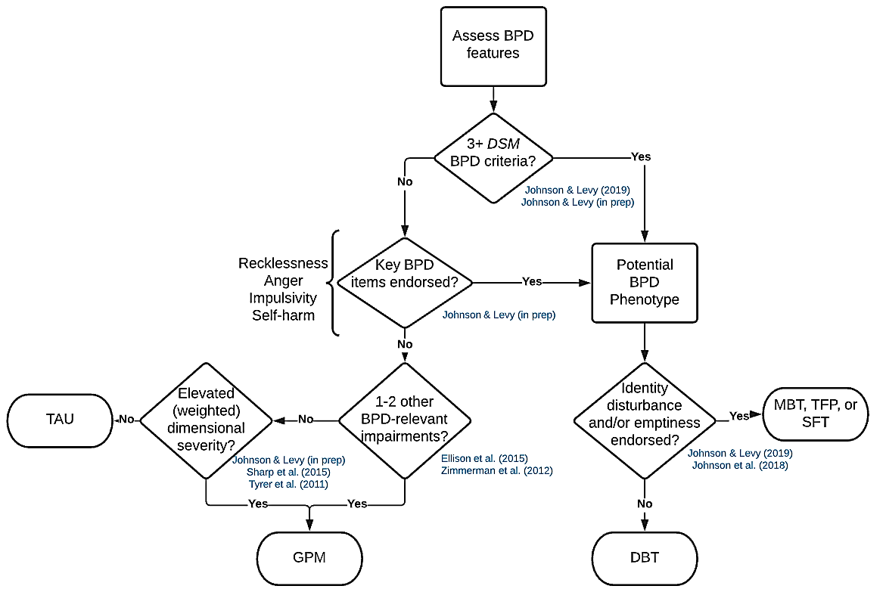
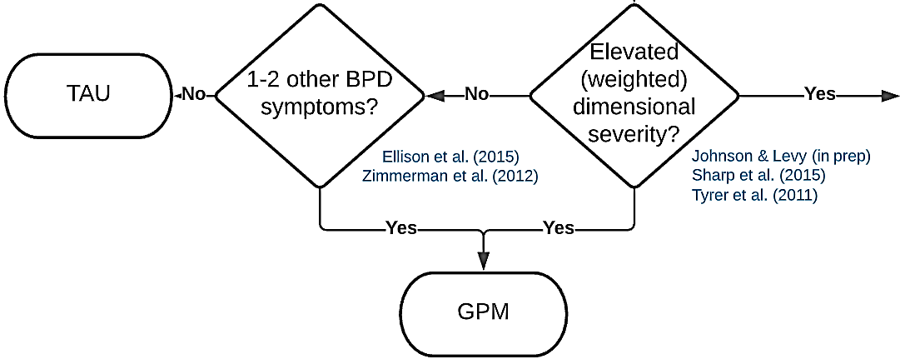
Treatment Matching Model
(aka “What might work best for me”?)

Slide 24
Stepped-Care Model
Specialized treatments
Good Psychiatric Management
Principles in everyday life

Slide 25
Barriers to Evidence Based Treatments
Time
Access
Availability
Money
Interest
Comorbidities
Cultural issues
Don’t solve everything
Don’t work for you

Slide 26
Find a therapist who is…
Comfortable with intense negative or painful emotions
Self-aware (e.g., receives supervision, consultation)
Flexible, open-minded
Compassionate (e.g., able to recognize your strengths)
Knows and believes people with BPD can get better
Plays an active role in your treatment
Doesn’t have to be directive or non-directive
Validating and challenging
Able to set and hold boundaries
This can help you learn to have a secure attachment
Has some specialized training in assessment and treatment of BPD
Uses a “hierarchical” approach to session content (e.g., knows that suicide or self harm are important to discuss)

Slide 27
Find a therapy that includes…
A thorough evaluation
Psychoeducation/diagnostic feedback
A framework, structure, and/or model for the treatment
Integrative flexibility while maintaining structure
A discussion of suicide, hospitalization, etc. at the beginning
Hospitalization should be a last resort
A focus on emotions
Increased frequency or type of sessions (e.g., individual + group) and/or longer length of treatment (e.g., >16 sessions)
Multimodal treatment (e.g., combines psychiatric care, skills)
Supervision/consultation for therapists

Slide 28
Psychopharmacology for BPD
There is little to no evidence that psychiatric medication can treat BPD
Currently, there are no FDA-approved medications for BPD
In fact, the number of medications someone takes is associated in the reverse with improvement
Some medications may help secondary symptoms (e.g., mood) or comorbid issues (e.g., ADHD), but psychotherapy is the gold standard treatment for BPD

Slide 29
Strategies to Optimize Recovery
Increase willingness to change and tolerate discomfort
Work on building self-compassion
Focus on your strengths
Create structure in your life/engage in meaningful activities
Seek and nurture supportive, reciprocal relationships (consider ending those that are damaging or interfering)
Take care of physical health and needs

Slide 30
Strategies to Optimize Recovery
Find community – support groups, recovery-oriented online forums/social media platforms
Psychoeducation – learn as much about BPD as you can from both clinical and lived-experience perspectives
The BPD Bunch (YouTube channel & podcast)
Borderliner Notes (YouTube channel)
Borderline Personality Disorder Demystified: An Essential Guide for Understanding and Living with BPD (Book)
Resources and psychoeducation for loved ones

Slide 31
Strategies to Optimize Recovery
Do not give up.
Remember that recovery is not linear
and is absolutely possible.

